Slide 1



Projeto Novos Horizontes Aula 2 Internet das Coisas
Felipe Kühne
fkuhne@dbserver.com.br
dblab@dbserver.com.br

Slide 2
Agenda
Definição
Histórico
Outras definições
Áreas de atuação
Arquitetura
Dispositivos de ponta
Gateways
Protocolos de comunicação
Edge computing
Segurança e privacidade
Serviços de cloud
Tema de casa

Slide 3

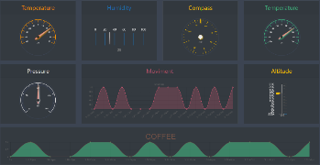
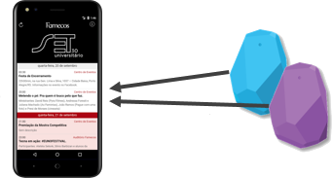





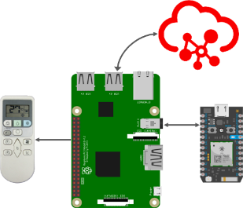
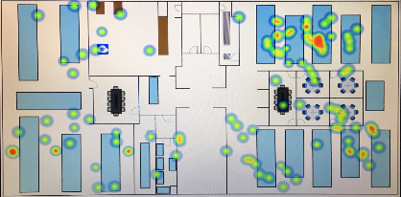
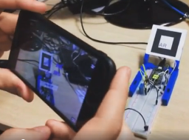
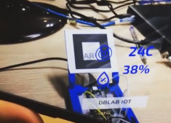
IoT no DBLab
Rede de sensores
Beacons e apps
IoT + Cloud
Mapa de calor
RA + IOT

Slide 4
O que é IoT?
“Sensors and actuators embedded in physical objects are linked through wired and wireless networks, often using the same Internet Protocol (IP) that connects the Internet.”
(McKinsey)

Slide 5
O que é IoT?
“IoT involves extending Internet connectivity beyond standard devices, such as desktops, laptops, smartphones and tablets, to any range of traditionally dumb or non-internet-enabled physical devices and everyday objects.”
(Wikipedia)

Slide 6
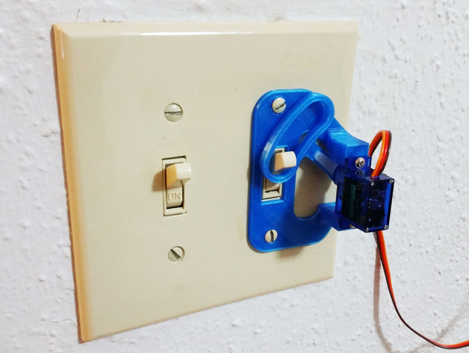
https://www.thingiverse.com/thing:1156995

Slide 7
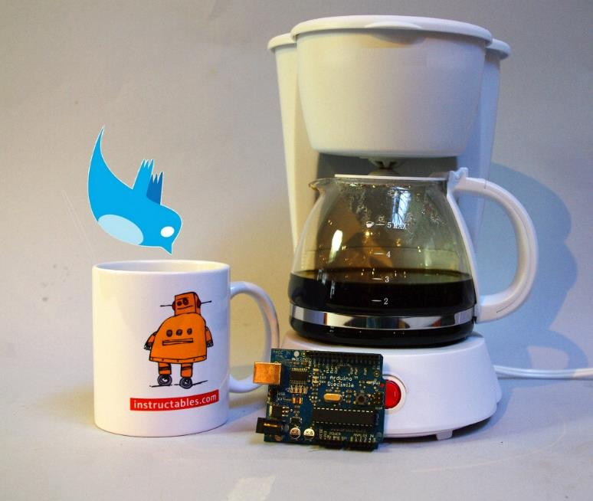
https://www.instructables.com/id/Tweet-a-Pot-Twitter-Enabled-Coffee-Pot

Slide 8
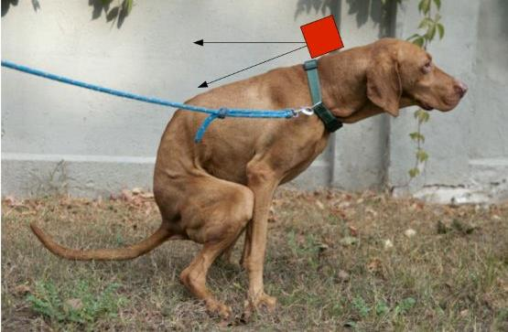
https://www.instructables.com/id/Uber-Home-Automation-w-Arduino-Pi

Slide 9
O que é IoT?
“É uma rede de objetos físicos dedicados com tecnologia embarcada que interage com seus estados internos e o ambiente externo.
A conexão de ativos, processos e pessoas habilita a captura de dados e eventos, e a partir dos quais uma empresa pode aprender sobre os seus usos e comportamentos, reagir com ações preventivas, ou ainda transformar e aumentar seus processos de negócios. IoT é uma ferramenta fundamental para a criação de negócios digitais.”
(Gartner)
https://www.gartner.com/imagesrv/books/iot/iotEbook_digital.pdf

Slide 10
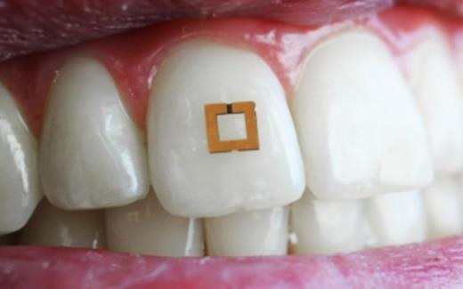
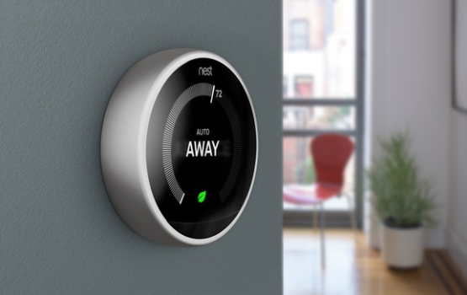
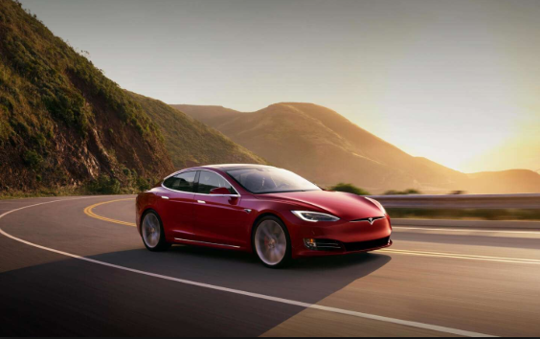
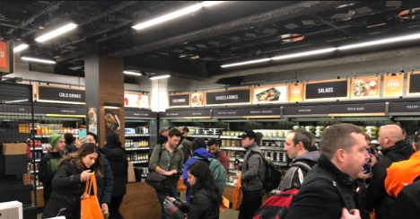
https://now.tufts.edu/news-releases/scientists-develop-tiny-tooth-mounted-sensors-can-track-what-you-eat

Slide 11
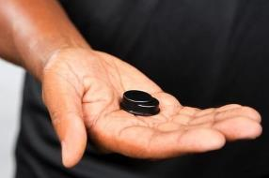
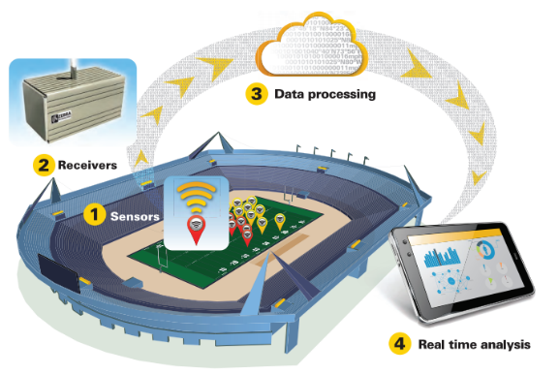
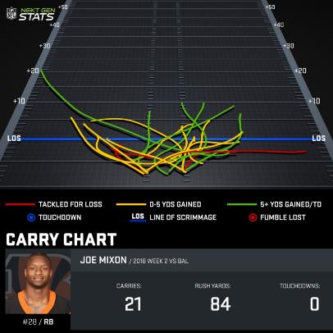
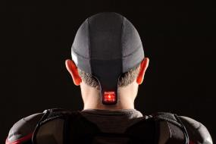
https://nextgenstats.nfl.com

Slide 12
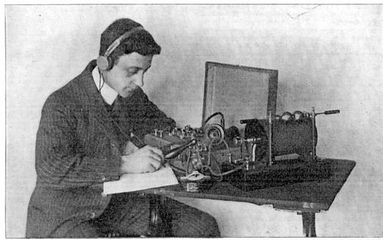
Histórico
1830 Telégrafo
1900 Transmissão de voz via rádio
1950 Computadores
1969 ARPANET

Slide 13
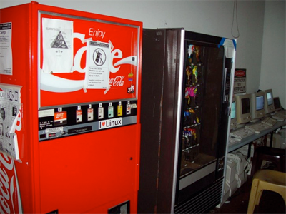
1978 Protocolo TCP/IP
1983 Internet Coke Machine
1992 WWW
1993 GPS

Slide 14
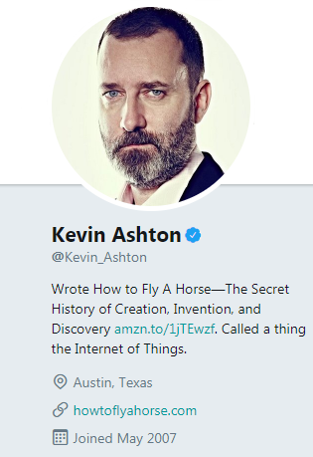
1999 Kevin Ashton - RFID e supply chain na
Procter&Gamble
2005 Movimento Maker com a plataforma Arduino e
a revista Make:
2010 Google StreetView (“indexing the physical
world”);
Plano de Desenvolvimento Chinês

Slide 15
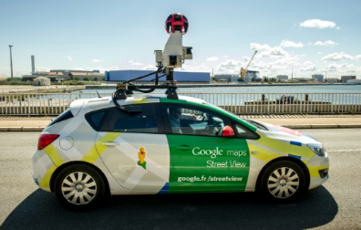
1999 Kevin Ashton - RFID e supply chain na
Procter&Gamble
2005 Movimento Maker com a plataforma Arduino e
a revista Make:
2010 Google StreetView (“indexing the physical
world”);
Plano de Desenvolvimento Chinês

Slide 16
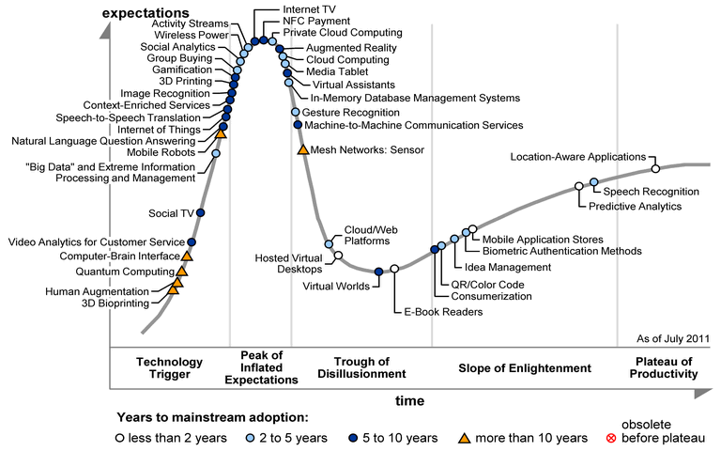
2011 Gartner Hype Cycle
2014 Google compra a Nest;
CES temática sobre IoT

Slide 17
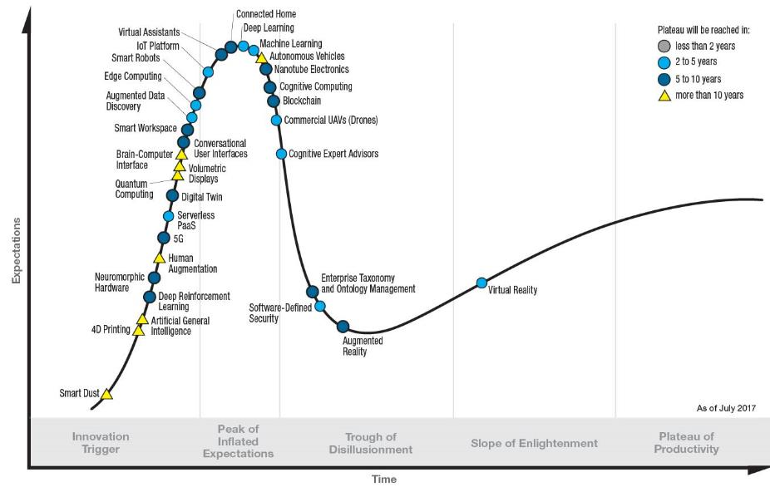
2017 Gartner Hype Cycle

Slide 18
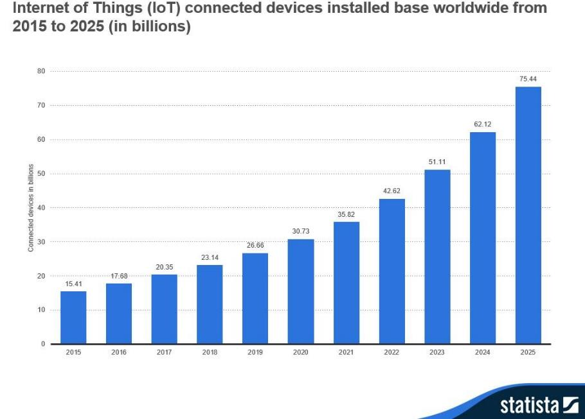
https://www.statista.com/statistics/471264/iot-number-of-connected-devices-worldwide

Slide 19
Outras definições
Machine to machine
Industrial IoT
Industry 4.0
Web of things
Internet of everything
Embedded internet

Slide 20
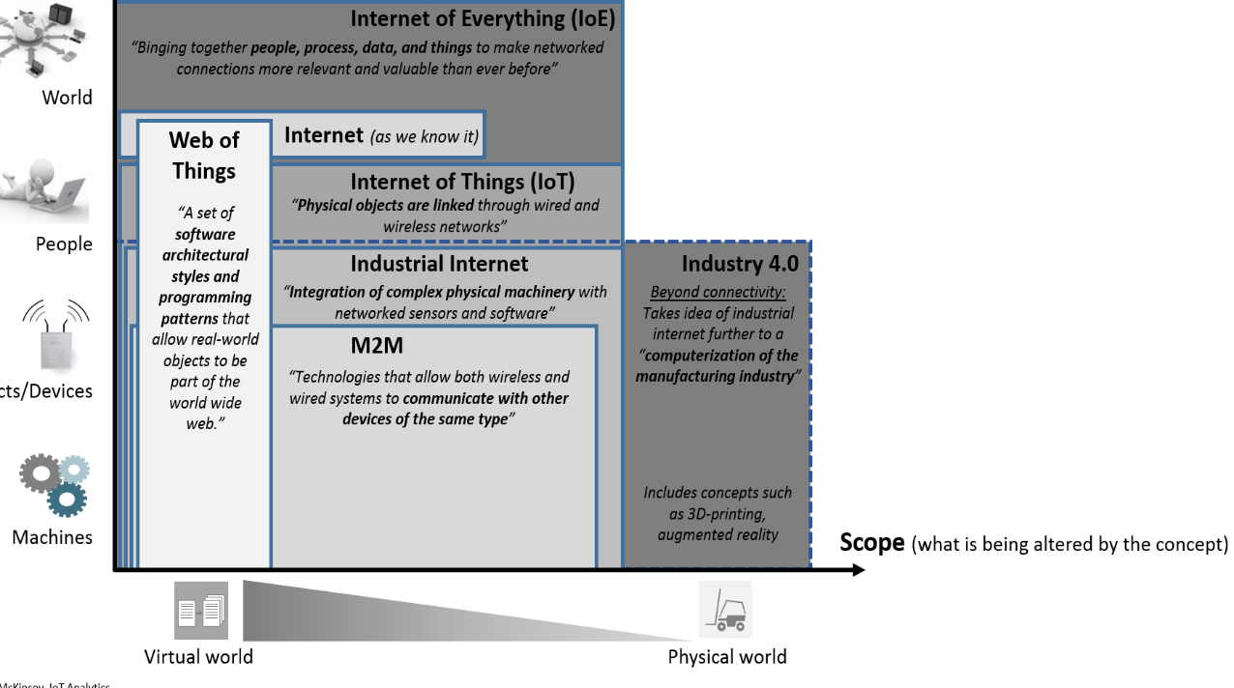

Slide 21
Áreas de atuação
Varejo
Saúde
Residencial
Pessoal
Agricultura
Transporte
Industrial

Slide 22
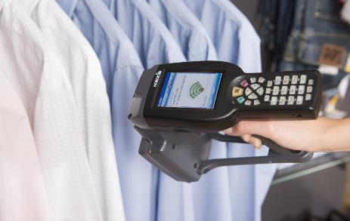
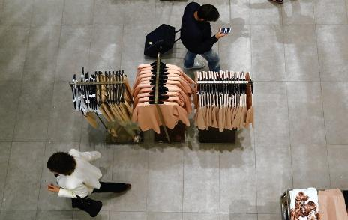
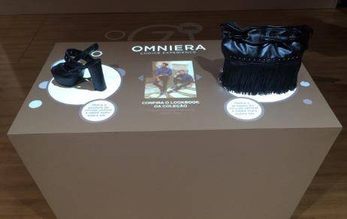
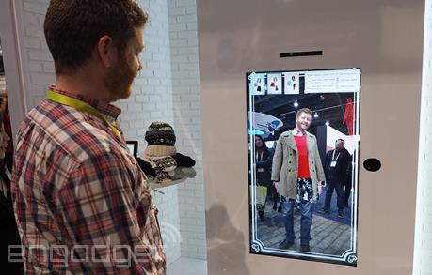
Varejo
http://www.advancedmobilegroup.com/blog/how-zara-controls-stock-with-rfid

Slide 23
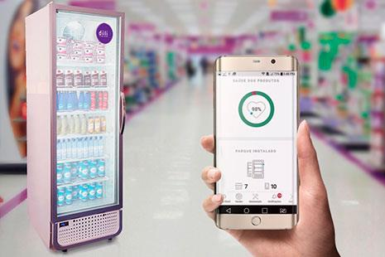
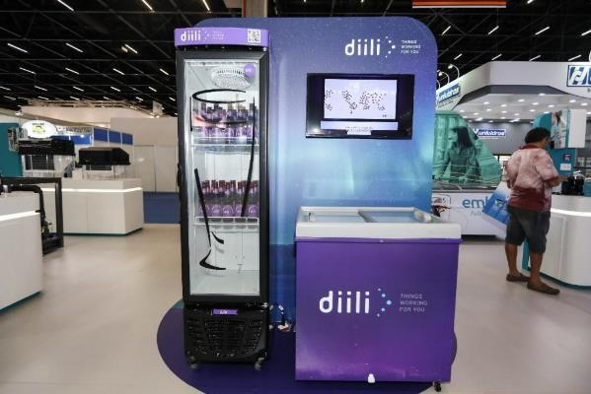
http://www.aberje.com.br/diili-e-plataforma-de-servicos-da-embraco

Slide 24
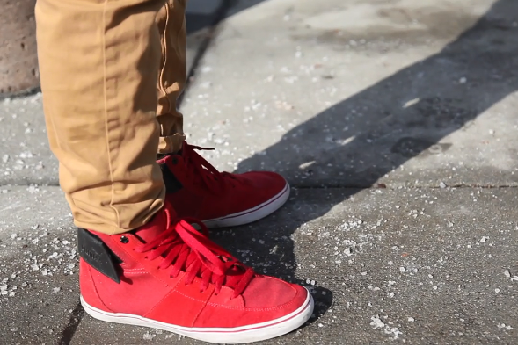
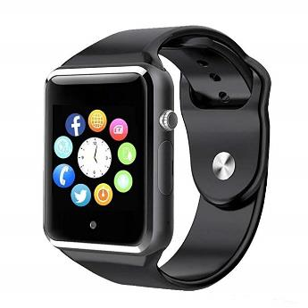
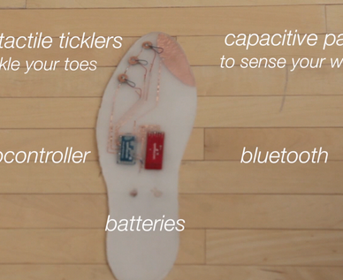
Pessoal
https://www.popsci.com/article/gadgets/toe-tickling-shoes-let-you-navigate-city-touch

Slide 25
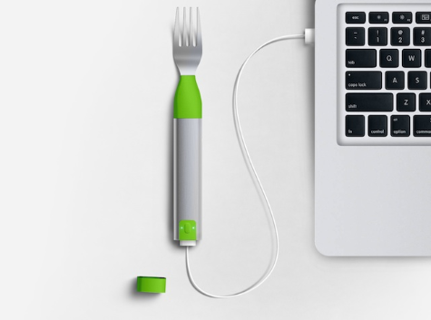
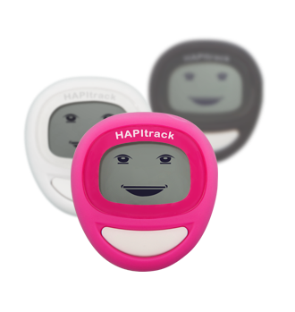
https://www.hapi.com/

Slide 26
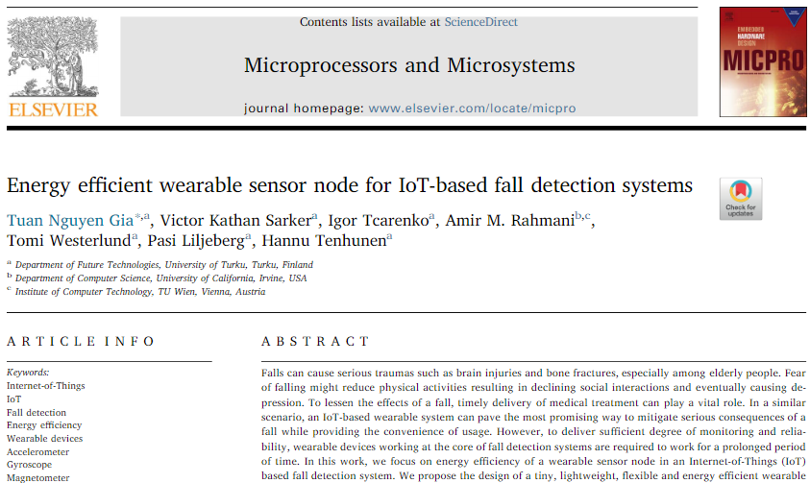
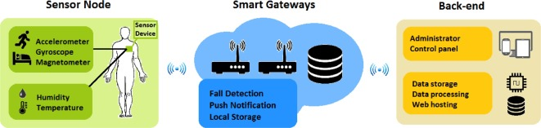
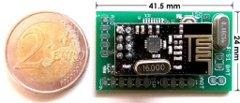
https://doi.org/10.1016/j.micpro.2017.10.014

Slide 27
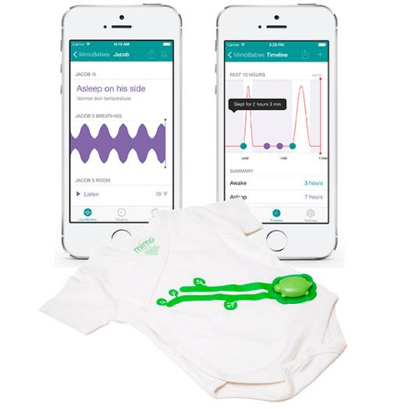
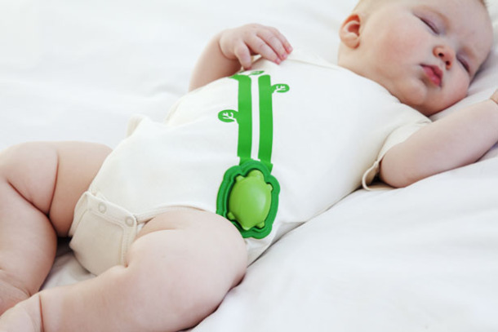
https://www.mimobaby.com

Slide 28
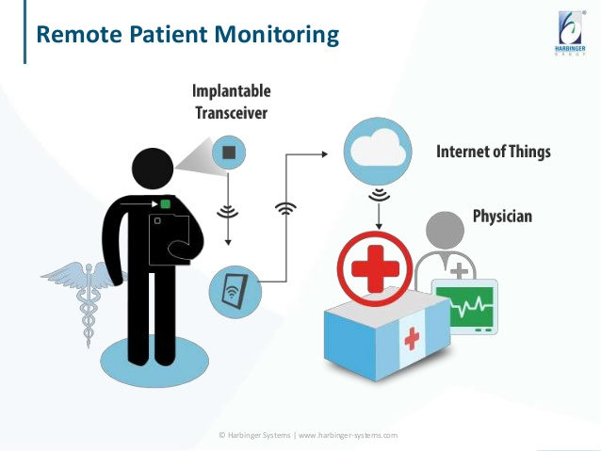
Saúde
https://www.iotforall.com/exciting-iot-use-cases-in-healthcare

Slide 29
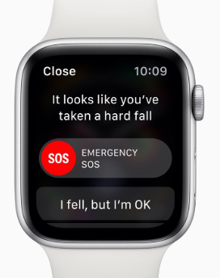
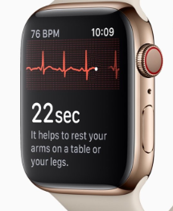
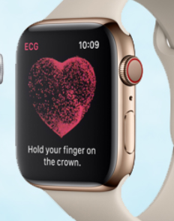
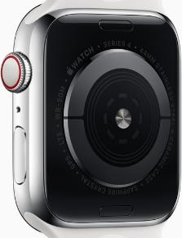
Sensor de queda
Medidor de batimentos
ECG
https://techreport.com/news/34089/apple-watch-series-4-can-help-keep-tickers-ticking

Slide 30
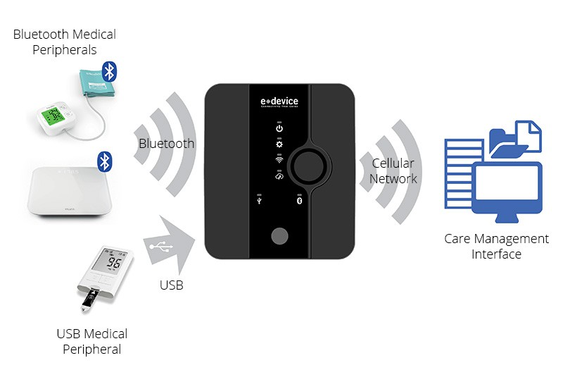
https://www.edevice.com/products/healthgo-mini

Slide 31
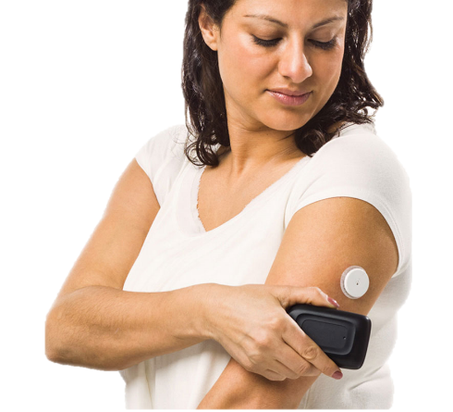
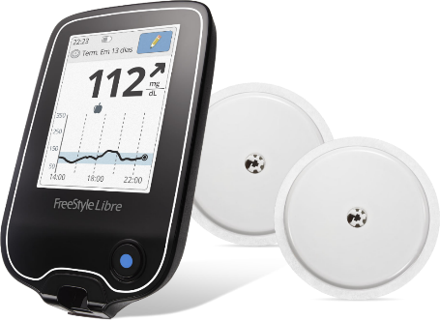
https://www.freestylelibre.com.br

Slide 32
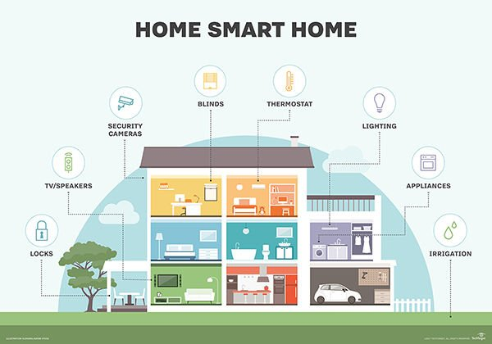
Residencial

Slide 33



Slide 34


https://www2.meethue.com/en-us

Slide 35



https://www.amazon.com/Dash-Buttons/b?ie=UTF8&node=10667898011

Slide 36


https://www.samsung.com/us/explore/family-hub-refrigerator/connected-hub

Slide 37


https://sense.com

Slide 38



Agricultura
https://agrosmart.com.br

Slide 39

https://www.ft.com/content/2db7e742-7204-11e7-93ff-99f383b09ff9

Slide 40
Cidades
Energy
Buildings
Mobility
Education
Governance
Citizen

Slide 41

https://www.corriere.it/international/18_giugno_29/milan-introduces-contactless-payment-for-ticket-free-metro-travel-c9787e88-7bab-11e8-ab49-1b15619f3f8e.shtml

Slide 42

http://www.pucrs.br/blog/huawei-e-pucrs-inauguram-centro-de-inovacao-para-cidades-inteligentes

Slide 43

27/12/2016
http://www.procempa.com.br/default.php?p_noticia=191030

Slide 44




http://site.sigmais.com.br

Slide 45

Transporte
https://www.engadget.com/2016/11/19/tesla-self-driving-demo-shows-car-view

Slide 46

https://www.wired.com/2015/04/cost-of-sensors-autonomous-cars

Slide 47

https://www.pcmag.com/news/348875/singapore-outfitting-buses-with-self-driving-sensors

Slide 48

https://iot.telefonica.com/smart-mobility/fleet-management

Slide 49
Hypes & Trends
Big data
IA
Mobile
Cloud
IOT

Slide 50








Arquitetura
DISPOSITIVOS
USUÁRIO
BACKEND
GATEWAY

Slide 51

https://docs.microsoft.com/en-us/azure/iot-fundamentals/iot-introduction

Slide 52



















Nós

Slide 53



Componentes básicos
Sensor
Sensor
Bateria
CPU

Slide 54

Gateway
https://software.intel.com/en-us/articles/what-is-the-gateway-and-why-should-i-care

Slide 55



http://linuxgizmos.com/private-cloud-server-and-iot-gateway-runs-ubuntu-snappy-on-rpi
https://www.adafruit.com/product/3943
https://software.intel.com/en-us/iot/hardware/gateways

Slide 56










Protocolos de comunicação
LoRA
Celular
Bluetooth
Thread
Wi Fi
Zigbee
6LowPAN
NFC
Z Wave
Sigfox
https://www.rs-online.com/designspark/eleven-internet-of-things-iot-protocols-you-need-to-know-about

Slide 57

Edge (ou fog) computing
“IoT is living on the edge”

Slide 58

“Each car driving on the road will generate about as much data as about 3,000 people”
https://www.networkworld.com/article/3147892/internet/one-autonomous-car-will-use-4000-gb-of-dataday.html

Slide 59


https://aiyprojects.withgoogle.com

Slide 60

“On-device vision processing to watch for motion, distinguish family members, and send alerts”
“By performing computer vision tasks within the camera, Nest reduces the amount of bandwidth, cloud processing, and cloud storage used versus the alternative of sending raw streams of video over the network.”
https://nest.com/cameras/nest-cam-iq-indoor

Slide 61

“AWS DeepLens was designed with deep learning in mind. With over 100 GFLOPS of compute power on the device, it can process deep learning predictions on HD video for real time.”
https://aws.amazon.com/deeplens

Slide 62


Segurança e privacidade
14/08/2017
https://techcrunch.com/2017/08/14/wifi-disabled

Slide 63




21/07/2015
https://www.wired.com/2015/07/hackers-remotely-kill-jeep-highway

Slide 64




10/08/2018
https://www.wired.com/story/hackers-steal-tesla-model-s-seconds-key-fob

Slide 65



17/08/2018
https://www.wired.co.uk/article/google-history-search-tracking-data-how-to-delete

Slide 66

https://www.amazon.com/Jiusion-Listening-Surveillance-Quad-band-Lightning/dp/B06X42SGPY

Slide 67


https://twitter.com/bjmay/status/1041833853852311553

Slide 68
Segurança e privacidade
CONFIDENCIALIDADE
AUTENTICIDADE
INTEGRIDADE
Proteger os dados de acessos não autorizados
Garantir a correta origem dos dados
Prevenir que os dados sejam modificados
https://www.oreilly.com/ideas/responsible-iot-design

Slide 69





Serviços de cloud
https://www.ibm.com/cloud/internet-of-things
https://azure.microsoft.com/en-us/services/iot-hub
https://cloud.google.com/solutions/iot
http://www.dojot.com.br
https://aws.amazon.com/iot

Slide 70
Gerenciar dispositivos
Armazenar dados
Apresentar informações
Agir conforme regras de negócio
Fornecer segurança
Executar algoritmos:
Analytics
Big data
Machine learning

Slide 71

TEMA DE CASA!!!
Questão teórica
pesquisar sobre o conceito de digital twin
Questão prática
pesquisar sobre a plataforma dojot
montar uma infraestrutura arquitetura de uso da plataforma dojot em uma solução de IoT para a DBServer

